Slide 1
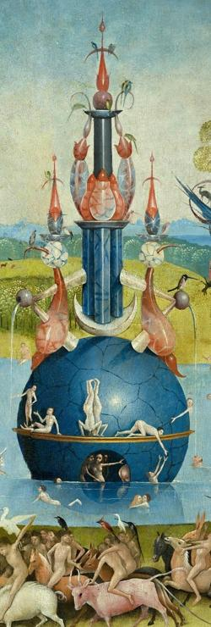

Classification
Extreme
A New Paradigm for
Ranking & Recommendation
Manik Varma
Microsoft Research India

Slide 2

Traditional Classification
Learning a small number of categories

Slide 3

Extreme Classification
Learning millions of categories
Notes:
Just above the shoes stop.

Slide 4




Extreme Classification in Academia
Applications: NLP (Language modelling, Tagging), Vision (Face recognition, Universal features), IR (Search, Ads), Recommender Systems, etc.
Publications at AAAI, AISTATS, CVPR, ECCV, ICML, ICLR,
IJCAI, KDD, NAACL, NeurIPS, SIGIR, WSDM, WWW, etc.
10 popular workshops at Dagstuhl, CVPR, ECML, ICML, NeurIPS, WWW, etc.
The Extreme Classification Repository provides code, datasets, metrics and benchmark results

Slide 5

Extreme Classification in Industry
Publications from Alibaba, Amazon, Baidu, eBay,
Facebook, Google, JD, Microsoft, NEC, Yahoo, etc.
Some papers from industry
Chang et.al.
Tan et.al
Guo et.al.
Medini et.al.
Shen et.al.
Yang et.al.
Krichene et.al.
Yi et.al.
Chang et.al.
Yen et.al.
Grave et.al.
Daumé III et.al.
Tagami
Niculescu-Mizil et.al.
Bhatia et.al.
KDD 2020
WSDM 2020
NeurIPS 2019
NeurIPS 2019
ArXiv 2020
WWW 2020
ICLR 2019
RecSys 2019
ICLR 2019
ICML 2018
ICML 2017
ICML 2017
KDD 2017
AISTATS 2017
NeurIPS 2015
Taming Pretrained Transformers for eXtreme Multi-label Text…
Fast Item Ranking under Neural Network based Measures
Breaking the Glass Ceiling for Embedding-Based Classifiers …
Extreme Classification in Log Memory using Count-Min Sketch Extreme Multi-label Classification from Aggregated Labels
Mixed Negative Sampling for Learning Two-tower NNs …
Efficient training on very large corpora via gramian estimation
Sampling-bias-corrected neural modeling for large corpus item rec.
Learning to screen for Fast Softmax Inference on Large Vocabulary
Loss Decomposition for Fast Learning in Large Output Spaces
Efficient softmax approximation for GPUs
Logarithmic time one-against-some
AnnexML: Approximate Nearest Neighbor Search for XML
Label Filters for Large Scale Multilabel Classification
Sparse Local Embeddings for Extreme Multi-label Classification

Slide 6


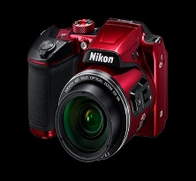


Extreme Classification in Industry
Parabel
Log time training and prediction
Applied to multiple Bing Ads products in various languages
Native
Ads
Text
Ads
Dynamic
Search
Ads
Product
Ads
Slice
Scales to 100 million labels
Applied to recommending Related Searches on Bing
Trigger Coverage | Suggestion Density | Success Rate | Tail Success Rate
52.01% | 33.0% | 2.62% | 12.62%

Slide 7
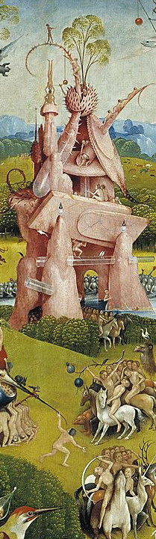
Open Research Challenges
New applications & scenarios
Short-text applications
Personalized extreme classification
Zero-shot scenarios
Algorithms
Scale to billions of labels
Deep extreme classification
Leverage label features
Tail labels
Algorithms
Metrics
Explore exploit

Slide 8
DeepXML
A Deep Learning Framework for Extreme Multi-label Learning
K. Dahiya†, A. Mittal†, D. Saini‡, A. Shaw†,
K. Dave‡, A. Soni‡, H. Jain†, S. Agarwal†&
M. Varma‡† (†: IIT Delhi, ‡: Microsoft)

Slide 9
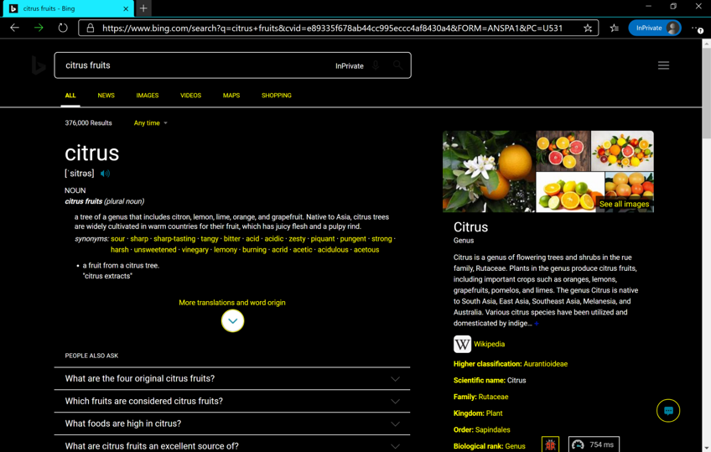
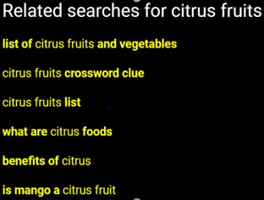
Short-text Applications

Slide 10

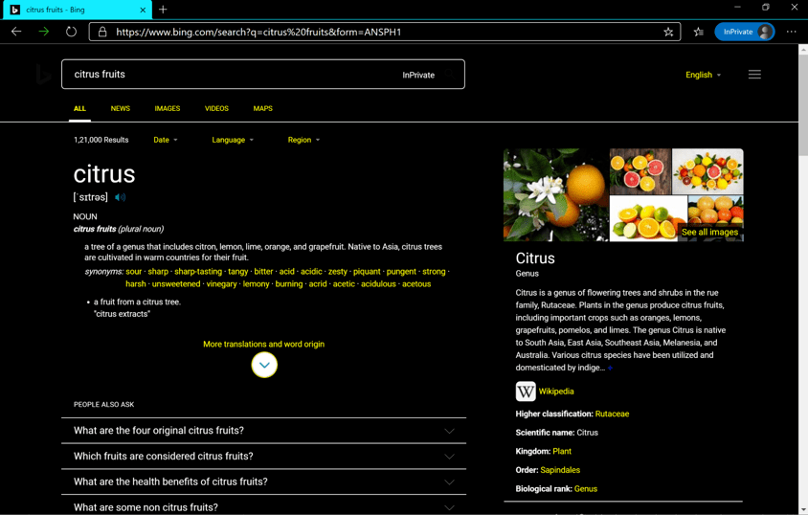
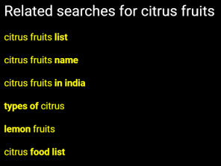

Personalized Extreme Classification

Slide 11



Personalized Extreme Classification
Scale of the Problem
Hundreds of billions of
web pages
Browse
A few billion users
Search
Billions of queries
Are Shown
Hundreds of billions of
ads

Slide 12
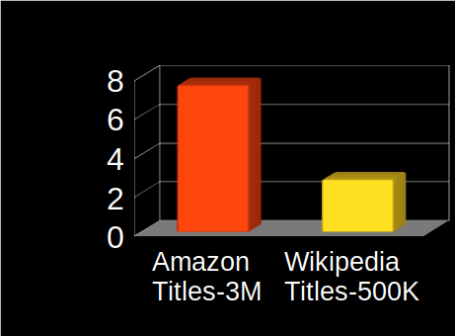
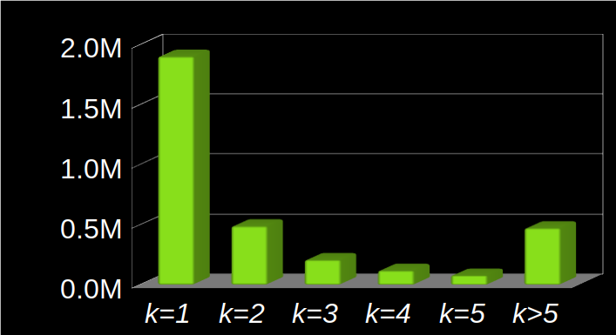
Challenges in Short-text Applications
Each document has only 3-10 words on average
Limited training data resulting in many tail tokens
CPU based predictions for low-latency applications
Average Tokens / Data Point
# Tokens having k Training Points

Slide 13

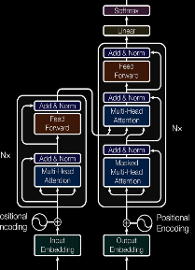




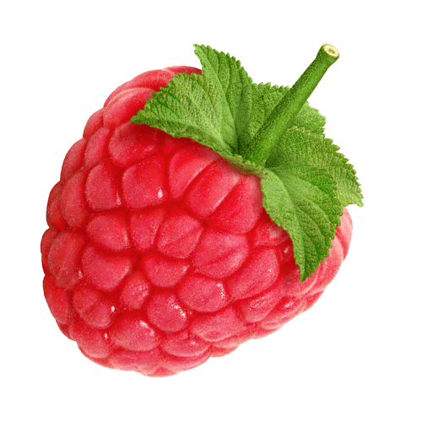
Challenges in Deep Extreme Classification
Fine-tuning BERT for 100 million labels is expensive
FCO Layer: Linear training & prediction costs are infeasible
Repeatedly computing sub-linear search structure is costly
``citrus’’
Label 1
``fruits’’
Label
100M
Query
BERT
Fully Connected
Output (FCO) Layer
FCO:
Fully Connected Output layer

Slide 14









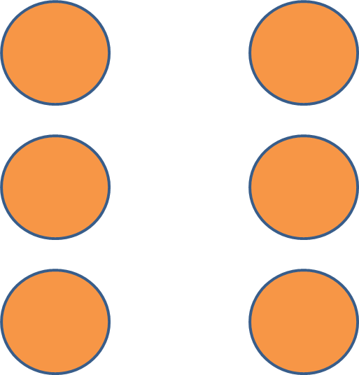


The DeepXML Framework
Can improve the scalability & accuracy of existing algorithms
Can lead to new algorithms
Astec: An Accelerated Short Text Extreme Classifier
“citrus”
“fruits”
Learning Inter-mediate features
Negative label
sub-sampling​
Transfers to
final features​
Joint classifier training​

Slide 15
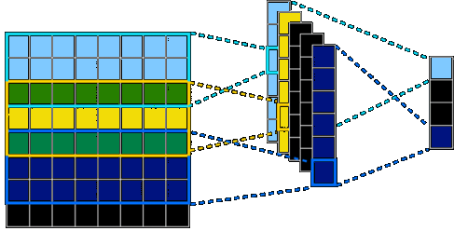
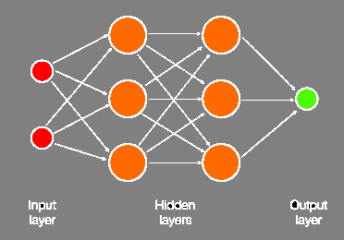


Learning Intermediate Features $z$
Learn $z$using a surrogate (non-extreme) task
Accuracy: $z$should lie close to the final features
Scalability: Train in time $O(ND\log{L})$
Convolution
(XML-CNN)
MLP
(MACH)
Attention
(X-BERT)

Slide 16

Astec Intermediate Features
TF-IDF weighted token embeddings
Accurate features can be learnt from limited data
Features can be computed in µs on a CPU
"citrus"
0.8
$$z$$
Intermediate
Feature Vector
0.6
"fruits"

Slide 17



Surrogate Learning Task
Train intermediate features on $O(\log{L})$ labels
Astec features can be learnt in a few hours
Token Accuracy​ | Token Coverage​ | Scalability​
Self-supervision​
Label Subset Selection​
Label Low-rank Projection​
Label Clustering​
 |  | ?

Slide 18



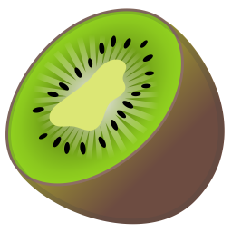







Negative Label Sub-sampling
Retain only $O(\log{L})$of the hardest –ve labels per data point
Selection carried out just once in time $O(ND\log{L})$
“citrus”
“fruits”
Intermediate
Feature Vector
l = 1 2 3
. . .
L

Slide 19
























Negative Label Sub-sampling
Leverage leading XC classifiers for pre-trained features
Label shortlist should have high recall & hardest negatives
Astec uses HNSW ANNS graph to train in just a few hours
Hashes
Trees
Graphs
Users
Items
$O\left(\log{L}\right)$ hash space
SLEEC, AnnexML, MACH
Parabel, PLT
Slice

Slide 20



Transfer to Final Features
Final features should be fine-tuned for the task at hand
Label shortlist should still contain the hardest negatives
Transfer should be statistically & computationally efficient
“citrus”
$$z$$
$$z+Δz$$
“fruits”
$$Δz$$
Intermediate Features
Transfer Learning
Final Features

Slide 21




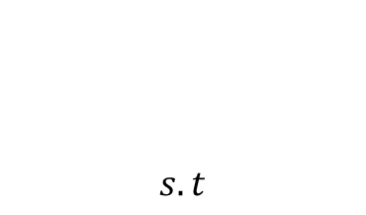
Astec Final Features
Final features fine-tuned through a residual block
Spectral regularization ensures that $z+Δz$ doesn’t lie too far away from thereby shortlisting the hardest -ve labels
$$z$$
“citrus”
$$z$$
$$z+Δz$$
“fruits”
$$Δz=ReLU\left(Rz\right) \\ \frac{|\left|Rz\right||}{||z||}≤1 ∀z≠0$$
$$s.t$$

Slide 22



Joint Classifier Training
Learn 1-vs-Some classifiers on $O\left(\log{L}\right)$ shortlisted labels
Trees or other classifiers could also be used
Train in time $O(ND\log{L})$
“citrus”
$$z$$
$$z+Δz$$
“fruits”
1-vs-Some

Slide 23
Astec Joint Classifier Training
Binary cross entropy loss optimized using sparse Adam
Trained in a few hours across datasets
“citrus”
$$z$$
$$z+Δz$$
“fruits”
1-vs-Some

Slide 24
Astec Re-ranker
The re-ranker can eliminate Astec's mispredictions
The re-ranker can be trained in < 2 hours across datasets
“citrus”
$$z$$
$$z+Δz$$
“fruits”

Slide 25
Astec Re-ranker
The re-ranker can eliminate Astec's mispredictions
The re-ranker can be trained in < 2 hours across datasets
“citrus”
$$z$$
$$z+Δz$$
“fruits”

Slide 26
Dataset Statistics
 | Dataset | # of Training Points | # of Labels | # of Test Points
Repository | WikiSeeAlsoTitles-350K | 629,418 | 352,072 | 162,491
 | WikiTitles-500K | 1,646,302 | 501,070 | 711,542
 | AmazonTitles-670K | 490,449 | 670,091 | 153,025
 | AmazonTitles-3M | 1,712,536 | 2,812,281 | 739,665
Bing | Q2B-3M | 21,561,529 | 3,192,113 | 6,995,038
Datasets available on The Extreme Classification Repository

Slide 27
Results on Repository Datasets
Astec can be 2-12% more accurate & 6-50x faster to train
WikiSeeAlso
Titles-500K
Wikipedia
Titles-500K
Amazon
Titles-670K
Amazon
Titles-3M
Accuracy
(P@1)
x
x
x
141
173
88
x
x
x
Training
Time (hrs)
x
x
x
Astec
XML-CNN
AttentionXML
MACH

Slide 28
Matching Queries to Bid Phrases
Astec was 20% more accurate than the state-of-the-art
Astec could be trained in 13 hours on a single GPU
Astec increased coverage by 8.6% & match quality by 2.9%
Precision @1
Propensity Scored Precision @1
Astec
Parabel
Slice
Simrank++
XReg
PfastreXML
Seq2Seq

Slide 29




Personalized Extreme Classification
Personalization for billions of users with QPS > 100 K
Astec increased the CTR by more than 6%
Visited Web Pages
Ad shown on MSN
book p&o cruise
book p&o cruise
baggage rules for cruise

Slide 30
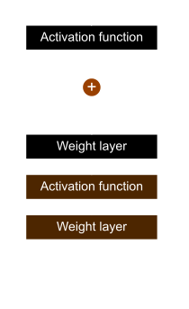

Visual Extreme Classification
Amazon product categorization from images
DeepXML can be 10% more accurate than other classifiers
Precision @1
ResNet18

Slide 31
Casting XML-CNN in DeepXML
Use XML-CNN's convolutional features in DeepXML
Can be 1.8% more accurate than the original XML-CNN
Can be 10x faster to train than the original XML-CNN
“citrus fruits”

Slide 32
Casting MACH in DeepXML
Use MACH's multi-layer perceptron features in DeepXML
Can be 2.4% more accurate than the original MACH
Can be 40x faster to train than the original MACH
“citrus”
“fruits”

Slide 33
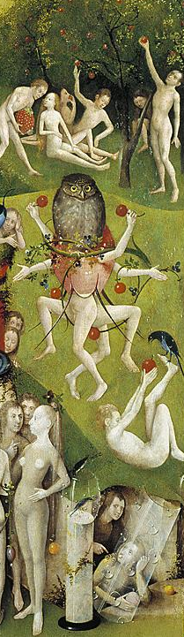
Conclusions
Short-text applications
Present new research challenges
Can benefit billions of users
DeepXML
Can improve state-of-the-art classifiers
Can lead to new classifiers that are scalable and accurate
Astec
Can be orders of magnitude faster to train
Can process billions of events per day
Can significantly improve offline & online metrics

